Slide 1
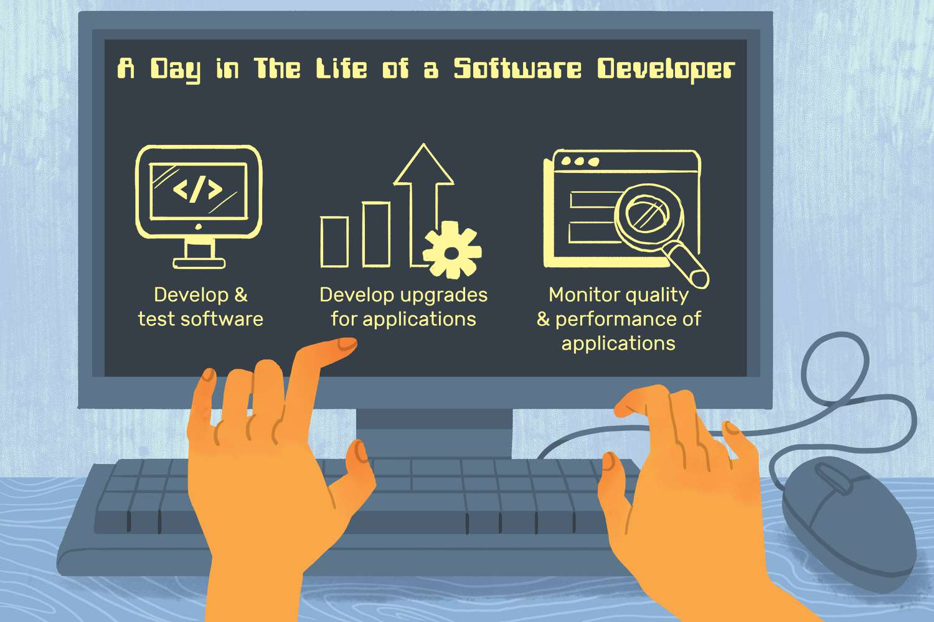

Software Architecture
Clean Architecture
N-Layer
Vertical Slice Architecture
Or Whatever solves your business

Slide 2

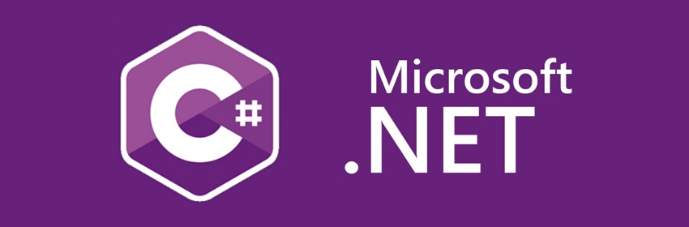
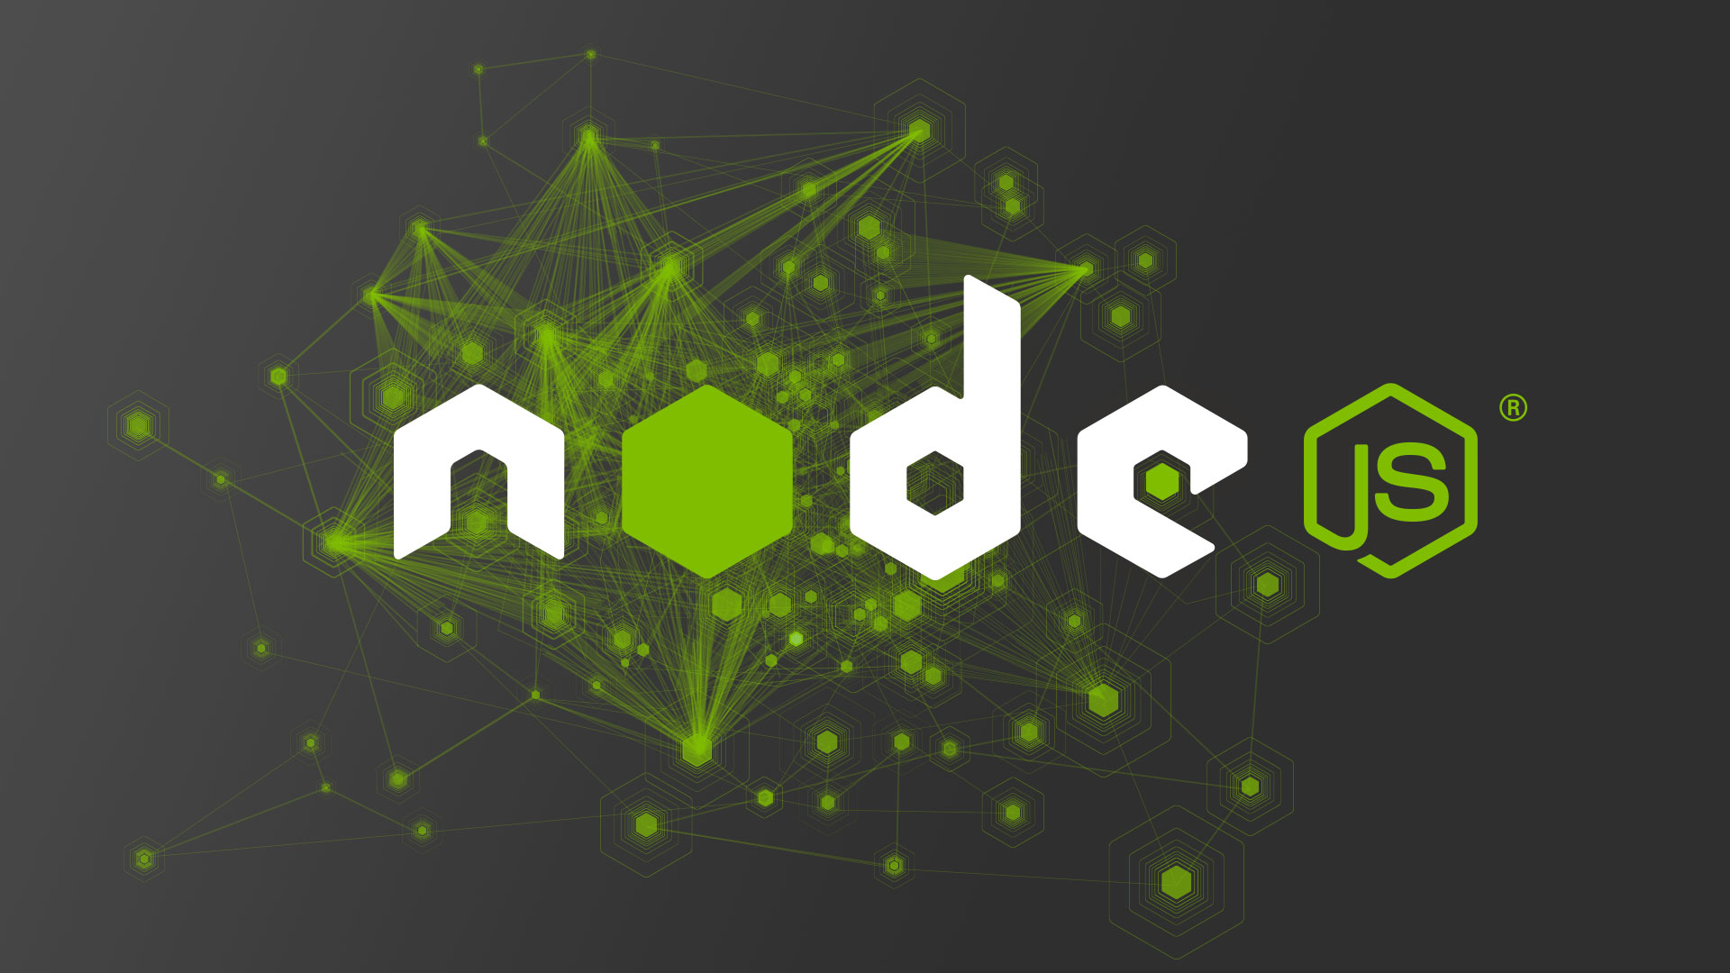
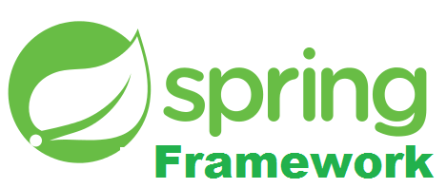
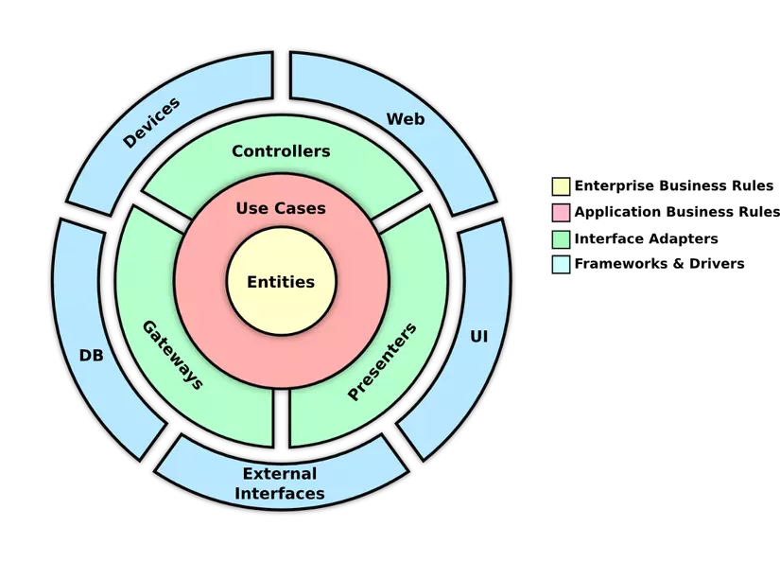
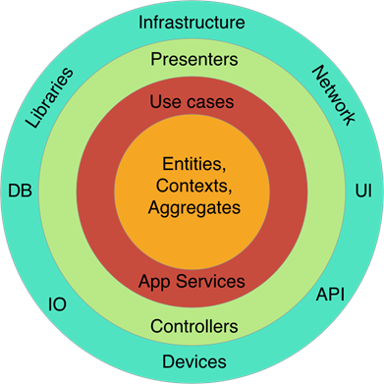
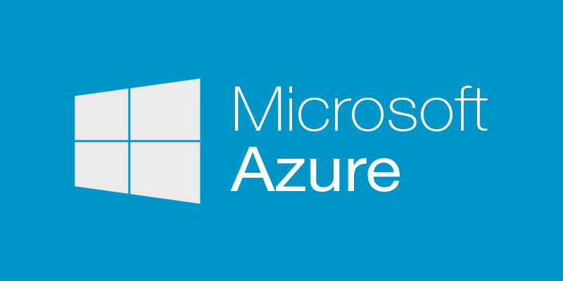

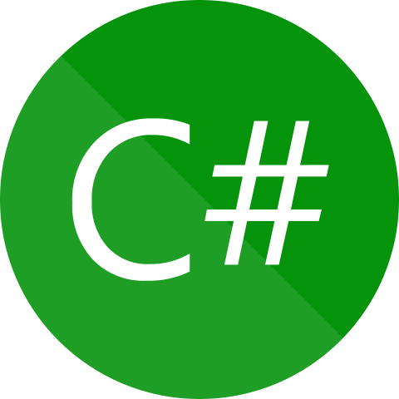

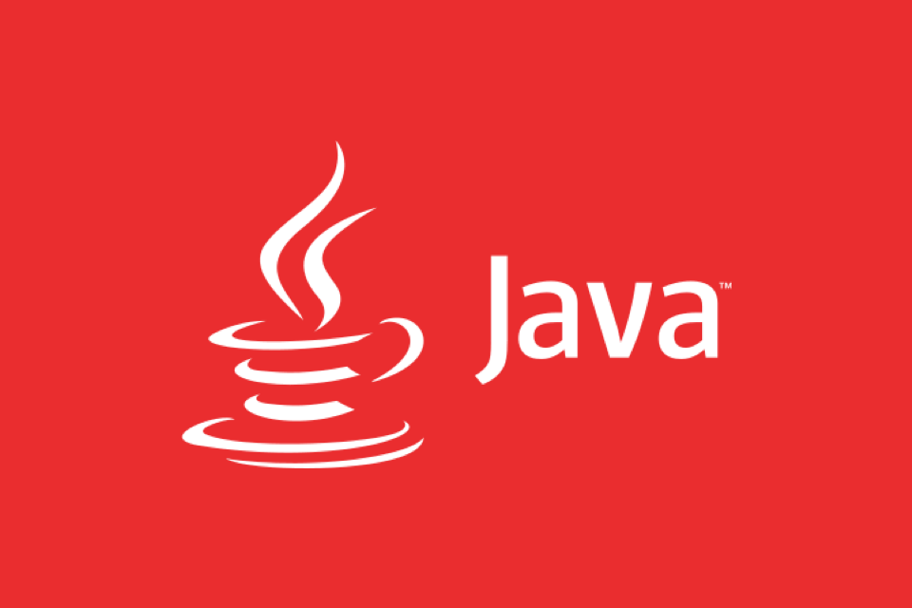
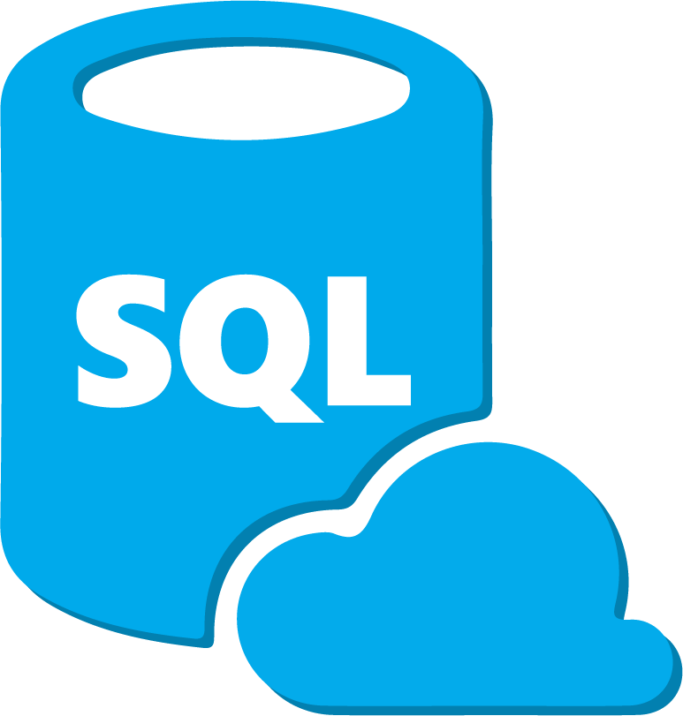
Hi, My name is Alex Nguyen
I’m proficient in
Clean Architecture
DDD

Slide 3
What are there?
N-Layer
Clean Architecture
Vertical slice
Monolothic
Micro services
CQRS
DDD
Serverless
Microkernel
TDD
Hexagonal
BDD
Event-Driven

Slide 4
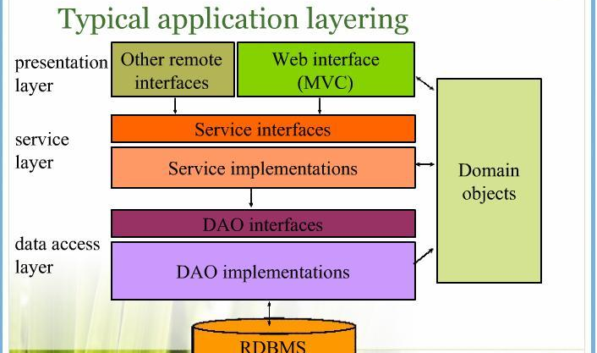
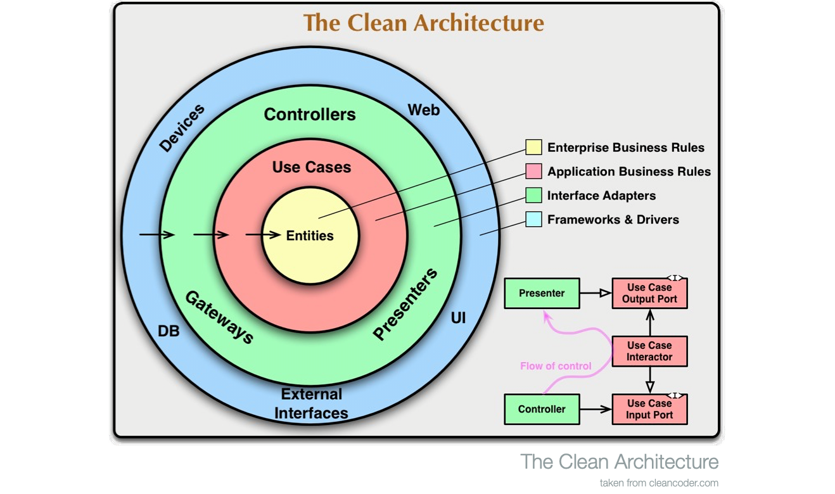
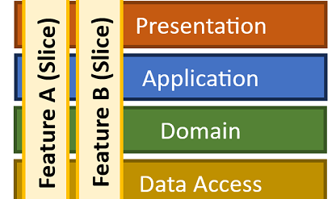
Agenda
N-Layer Architecture
Clean Architecture
Vertical Slice Architecture

Slide 5
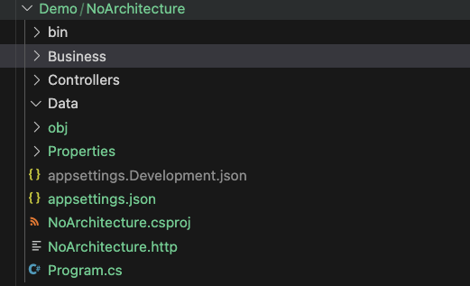

No Architecture
Client
Request
Web Api
Presentation
Business logic
System logic
use
Database

Slide 6
No Architecture
Pros
Little or No Abstraction
Easy & quickly to build from nothing to deploy.
Potential for performance due to tight coupling & less abstraction.
Cons
System expansion invariably leads to increased development costs.
Difficult for multiple teams
Difficult for testing
Break or impact the whole system due to technology changes change.

Slide 7
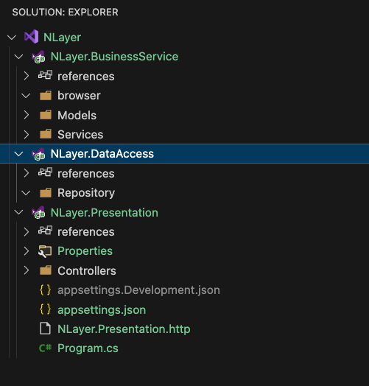
N-Layer
Client
Request
Presentation
Business services
Data Access
Database

Slide 8
N-Layer
Cons
The size of system increase does take time to develop
Technology changes impact to the whole system
Difficult for multiple team at once
Everything depends on Data Access layer.
Pros
Fairly intuitive abstraction to start
Improve testability
Reasonably quick to build

Slide 9
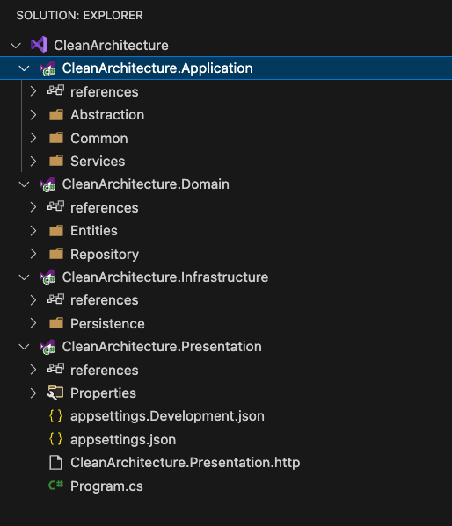
Clean Architecture
Presentation
Infrastructure
Depend on
Depend on
Application
Depend on
Domain

Slide 10
Clean Architecture
Presentation
Infrastructure
Depend on
Depend on
Presentation
Application
Domain
Application
Depend on
Infrastructure
Domain

Slide 11
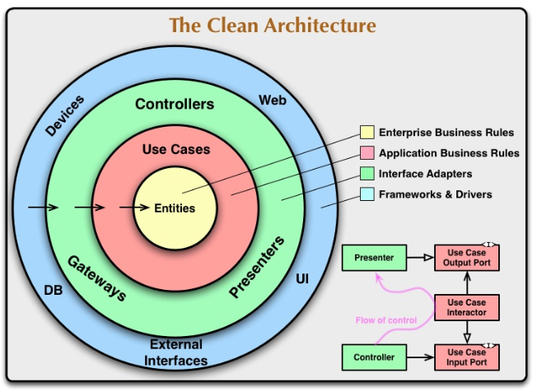
Clean Architecture
From The Clean Code Blog - by Robert C. Martin (Uncle Bob)

Slide 12
Clean Architecture
Pros
Highly abstracted for the large system
Very testable
Resilience to technology change
Not influenced by anything external
Easy to work on by a few teams
Cons
Higher barrier to entry
Depends on training & a disciplined team to utilise it well
Slower development time overall
Lots of code to write a simple feature.

Slide 13
Vertical slice
Clean Architecture - What happens in a request ?
Create Todo endpoint
Read ToDo Endpoint
Presentation
Create todo service
Read ToDo service
Application
Create an entity
Read ToDo entity
Domain
Create Db operation
Read Db operation
Infrastructure

Slide 14
Vertical slice
Proximity principle
Code is changed together should live together
Create an endpoint
Presentation
Read ToDo Endpoint
Slice
Create a service
Read ToDo service
Application
Create an entity
Read ToDo entity
Domain
Create Db operation
Read Db operation
Infrastrucure

Slide 15
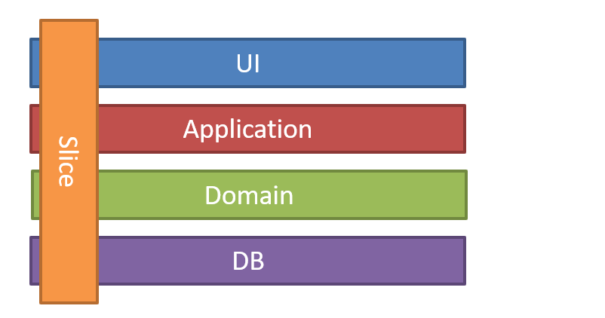
Vertical slice
Minimize coupling between slices,
and maximize coupling in a slice.
From Jimmy Bogard blog

Slide 16
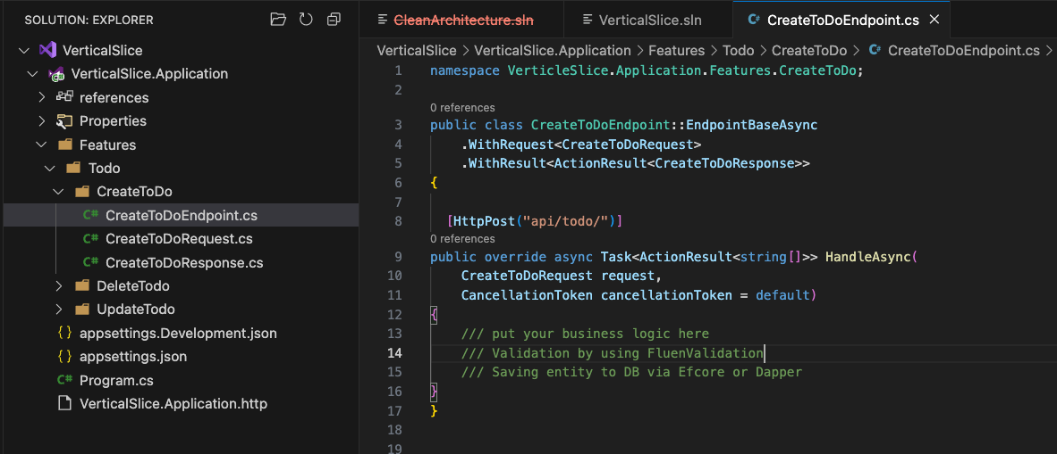
Vertical slice
Minimize coupling between slices,
and maximize coupling in a slice.

Slide 17
Vertical slice
Cons
Require contracts & messaging when working in large scale system.
Hard to decice what to have as Shared Code vs Feature Code
Each feature can be written in a different way leading to cognitive load when switching.
Pros
Little to no abstraction
Lower barrier to entry
Resilient to technology changes
Level of testability can be per feature
Easy to work on by many teams
Feature changes have no impact on other features

Slide 18
Best Architecture
The one of that effectively addresses the specific needes and challenges of your business, a lighing closely with its goals and requirements

Slide 19
Best Architecture
Strengths and trade-offs
Security
Scalability
Cost and Resource
Maintainability
Industry Standard and regulations
Flexibility Adaptability
Technology & Team Expertise
Performance

Slide 20
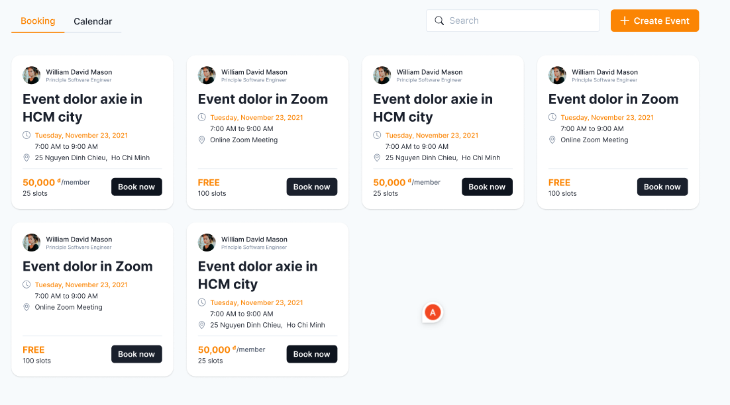
Demo
Booking system

Slide 21
Demo
Booking system
None-funtional requirements
Support multi databases
Support multi login provider
High scalability
1M visit per day
High performance
1k user per hour must provide 6s response time including rendering text & image.
Support Web and mobile app.

Slide 22
Demo
Presentation
Feature
Feature
Feature
Feature
Feature
Application
Domain
Shared Code
Infrastructure

Slide 23
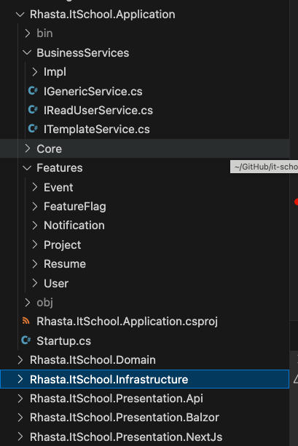
Demo
1
2
3
4

Slide 24
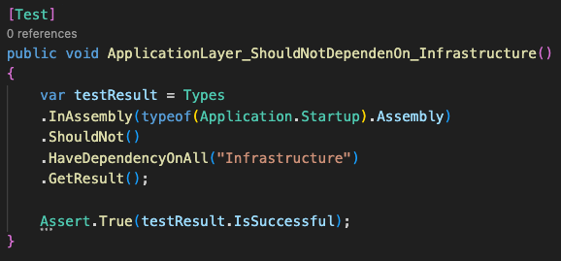
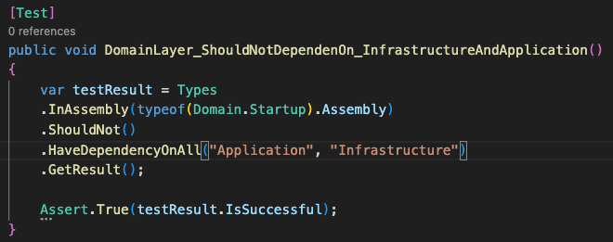
Demo

Slide 25
Demo
Pros
Little to no abstraction
Resilient to technology changes
Level of testability can be per feature
Easy to work on by many teams
Feature changes have no impact on other features
Cons
Require contracts & messaging when working in large scale system.
Depends on training & a disciplined team to utilise it well

Slide 26
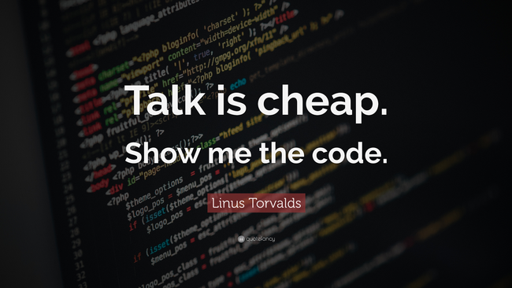
Demo

Slide 27

Pillars of Success
Domain
SoC (Separation of Concerns)
Maintainability
Testability

Slide 28
Thank you
chuong.nguyen22@logixtek.com
alex.nguyenxl@gmail.com
https://www.linkedin.com/in/alex-nguyen-166981100/
Demo : https://github.com/it-school-vn/CleanArchitecture-vs-SliceArchitecture

